Slide 1
Associative containers in C++

Slide 2
Motivation
1.
Why would we use set?

Slide 3
We want to store unique elements in an ordered container and we want fast interogation time.

Slide 4
Definition
2.
What is a set?

Slide 5
Definition
Sets are containers that store unique elements in an ordered way, and allow for fast retrieval of individual elements based on their value:
the value of an element is at the same time its key
the elements in a set cannot be modified in the container
organized into a balanced binary search tree

Slide 6
Methods
3.
How can we operate upon an unordered set?

Slide 7
Capacity
empty(): test whether container is empty
Complexity: constant
size(): return container size
Complexity: constant
max_size(): this is the maximum potential number of elements the container can hold due to system constraints or limitations on its library implementation
Complexity: constant

Slide 8
Element lookup
find(): get iterator to element
Complexity: logarithmic in container’s size
count(): count elements with a specific key
Complexity: logarithmic in container’s size

Slide 9
Modifiers
emplace()
Complexity: logarithmic in container’s size
emplace_hint()
Complexity: amortized constant
insert()
Complexity: logarithmic in container’s size
erase()
Complexity: logarithmic in container’s size
clear()
Complexity: linear
swap()
Complexity: constant

Slide 10
Example
4.

Slide 11
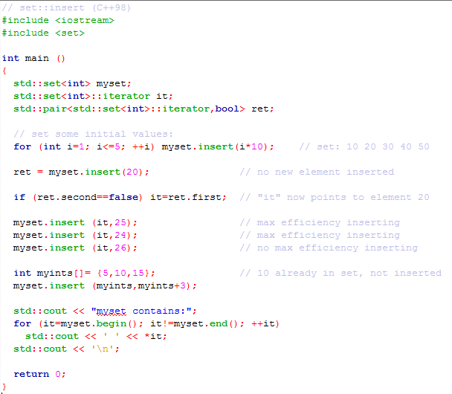
Example

Slide 12
Behind the scene
5.

Slide 13
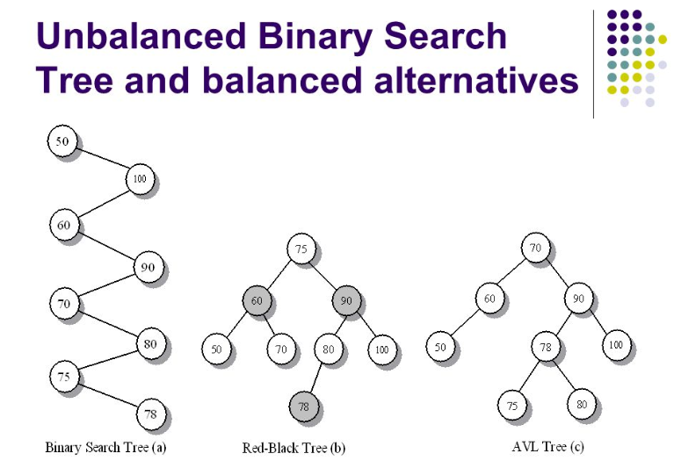
The magic

Slide 14
Comparison
6.

Slide 15
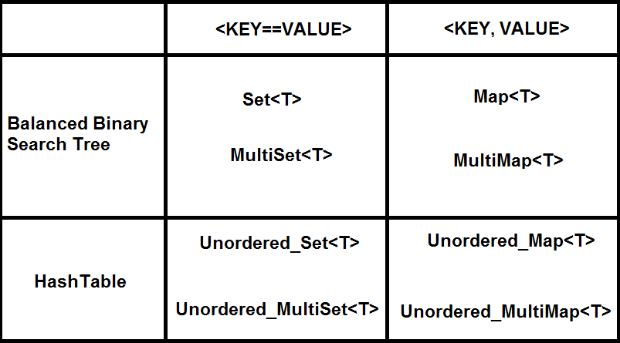
Set vs Map

Slide 16

Happy Holidays!

